Slide 1
Introduction to python programming
"Python: Your Key to Mastering AI Fundamentals."

Slide 2
Agenda
Python Scripting - some basic nuances
An overview of scripting and the pragmatic development approach.

Slide 3
Python Scripting - some basic nuances
Whitespace and Indentation: Python uses indentation to define code blocks, such as loops and conditional statements.
Consistent indentation is essential for the code to be valid and execute correctly.
Comments: Comments in Python start with the # symbol and are used to provide explanations or notes within the code.

Slide 4
Python Scripting - some basic nuances
Importing Modules: using the import statement to access additional functionalities.
Virtual Environments: Virtual environments allow you to create isolated Python environments for different projects,
Package Installation: using the package manager pip. For example, pip install package_name.
Debugging: Python provides various tools for debugging, including print statements, pdb (Python Debugger), and IDE/debugger integration.
Code Formatting: Following Python's PEP 8 style guide enhances code readability and maintainability.

Slide 5
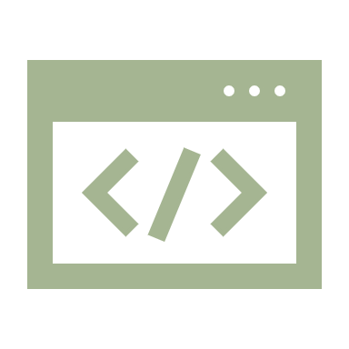
scripting and the pragmatic development approach
Characteristics of Scripting Languages
Interpreted: Scripting languages are typically interpreted, meaning the code is executed line by line without a separate compilation step.
Dynamic Typing: Scripting languages often use dynamic typing, where variable types are determined at runtime, offering flexibility but may result in some trade-offs.
Rapid Development: Scripting allows for fast and iterative development, making it well-suited for prototyping and smaller projects.
Simplified Syntax: Scripting languages often have simpler and more concise syntax, making them easy to learn and use.

Slide 6
The Pragmatic Development Approach
Iterative Development: The pragmatic approach emphasizes iterative development, where code is frequently tested and refined in small increments to quickly address issues and incorporate feedback.
1
Avoiding Over-Engineering: Pragmatic development discourages over-engineering and unnecessary complexity. Developers focus on delivering the most important features and avoiding premature optimization.
2
Flexibility and Adaptability: Pragmatic developers prioritize adaptability and flexibility, embracing changes in requirements and technologies to meet evolving needs.
3
Automated Testing: Automated testing is a vital part of pragmatic development, enabling faster and safer code changes while maintaining high code quality.
4
Continuous Integration and Continuous Deployment (CI/CD): CI/CD practices automate the process of integrating code changes and deploying software, reducing manual efforts and enhancing development speed.
5
User-Centric Approach: Pragmatic development emphasizes understanding and prioritizing user needs, ensuring the software delivers value to its intended users.
6

